Slide 1
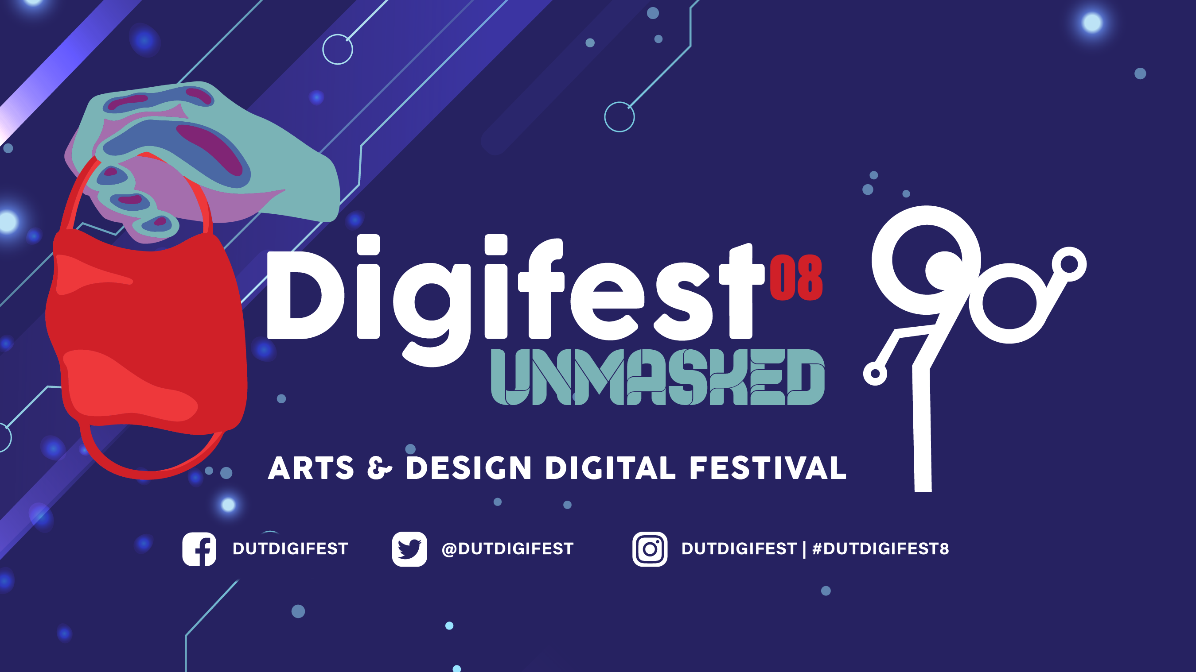
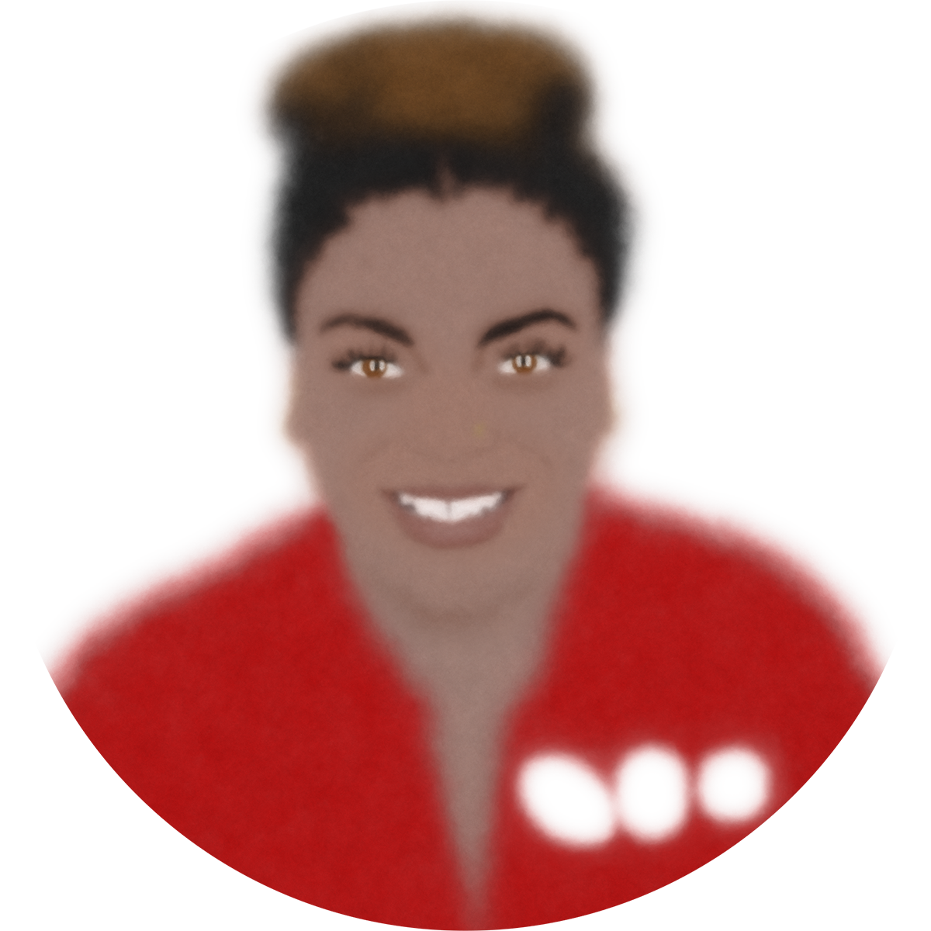
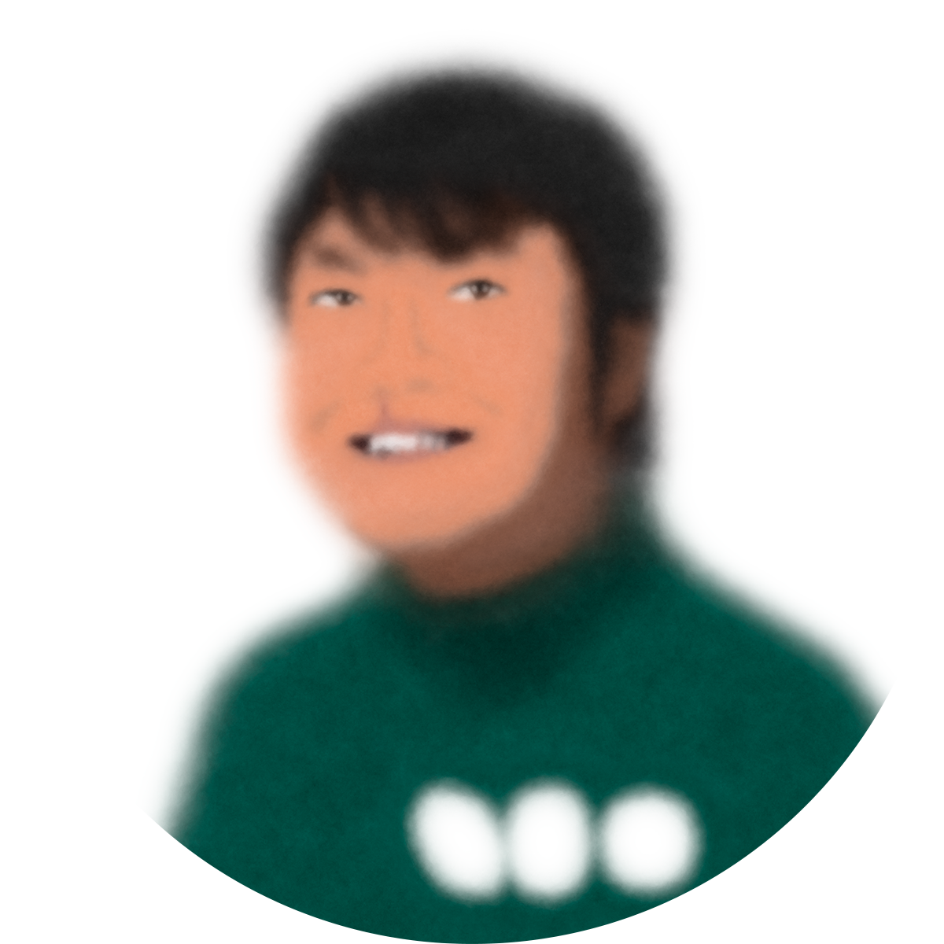
Dankie!
Notes:
[1] We’ll begin from the very last slide of last October’s DigiFest 8.

Slide 2
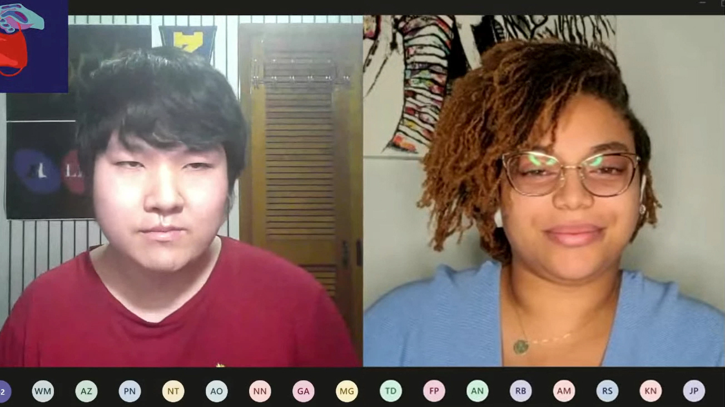
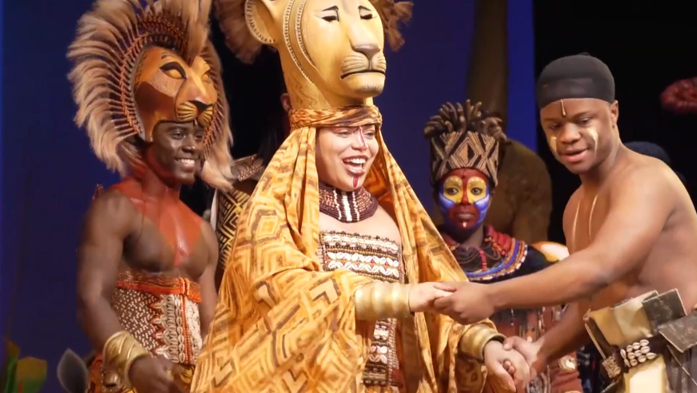
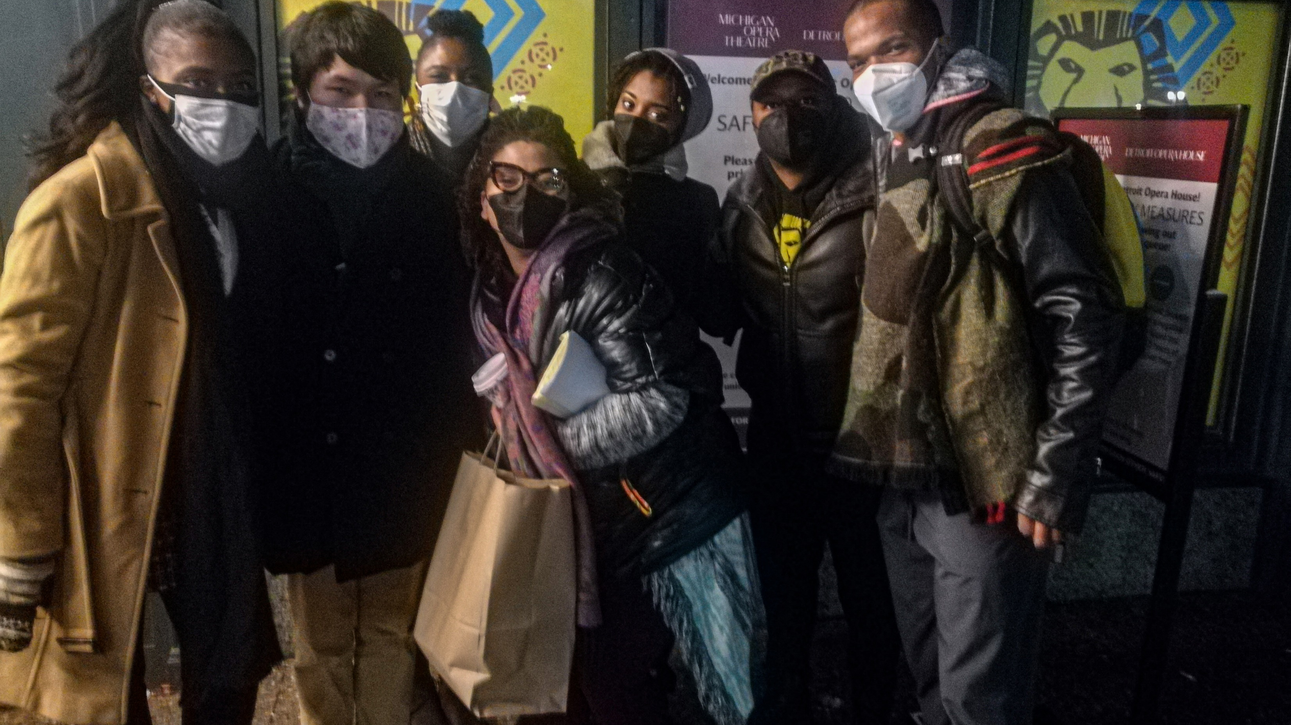
Notes:
[2] I was about to say that you can revisit last year’s presentation, but Jodie’s computer rebooted during our talk so most of that recording is lost. Good news though: There is no evidence that slides are being reused. Daniela Cobb, my fellow speaker last year, is making good use of her time. [2-] She is performing in The Lion King tour. [2--] When they came to Detroit, I got to attend the production with two college friends and meet her fiancé Nhlanhla.

Slide 3
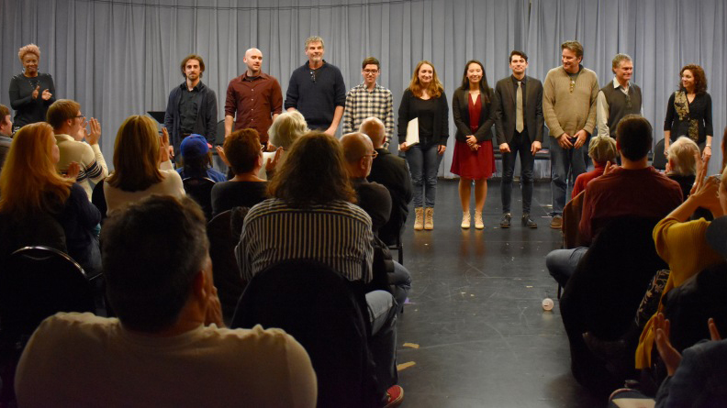
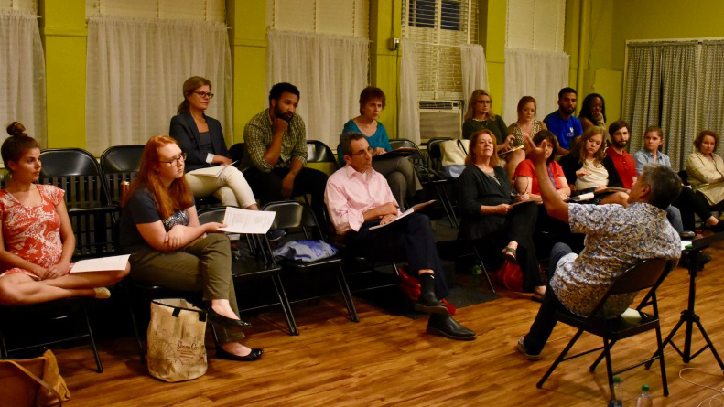

Notes:
9:18AM: How did the 2020-2021 lockdown unleash our creativity and inspire ELLIPSES?
As a musical writer, I give years away to this process. [3] Musicals, like The Lion King, went through many stages before getting to the real one. [3-] After some drafts, it must be passed on to other professionals. Then, actors read or sing from the script. [3--] Then, they’re workshopped where only parts of the musical are showcased. Then the audiences give feedback. And we do these on repeat until the work is clean enough to get a full production. Before the lockdowns of 2020, plays went through this process. In August 2020, Working Title Playwrights in Atlanta, Georgia made me their second apprentice. And that changed my life. It was my first professional title in a theatre company. It is a chance for formal education in playwriting.

Slide 4
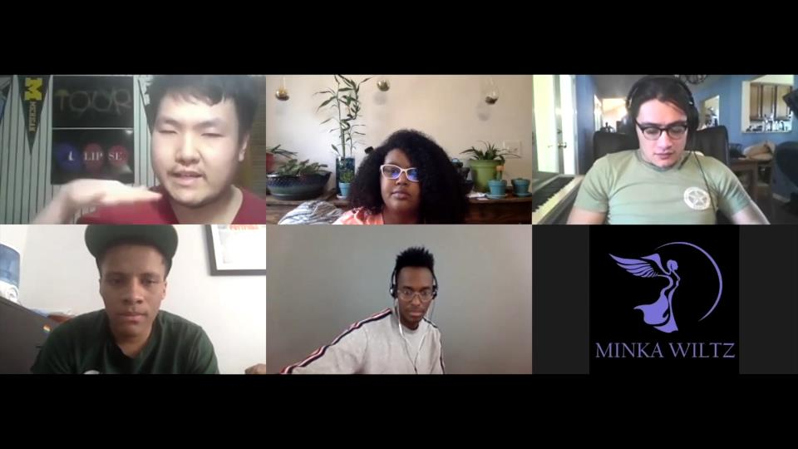
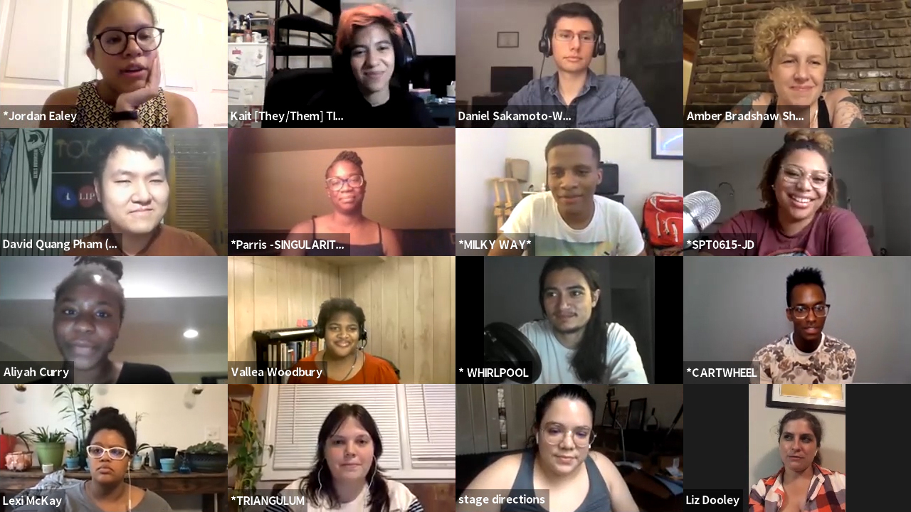
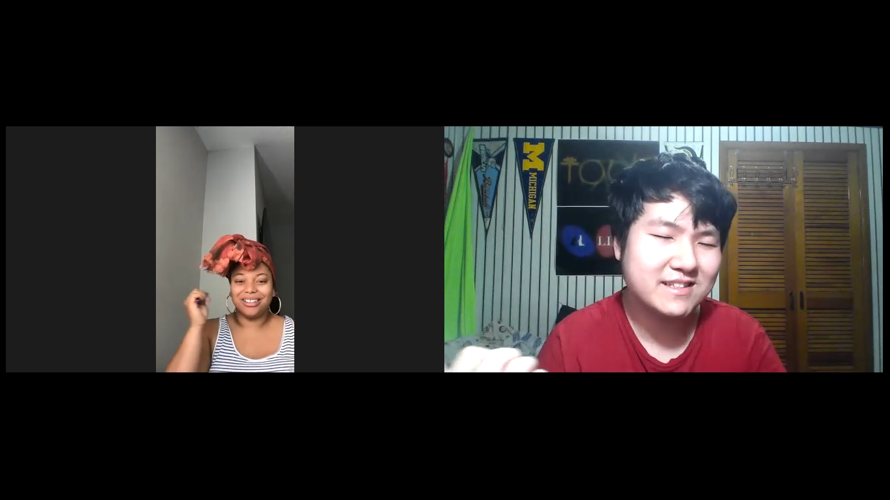
Notes:
[4] [4-] [4--] Working Title Playwrights assembled our team. This was an astronomical undertaking as this was a large-cast team in a hard-to-maneuver theatre landscape. But we managed in a safe and fun way for the rest of the apprenticeship. Here is the group photo of the ELLIPSES Atlanta team.

Slide 5

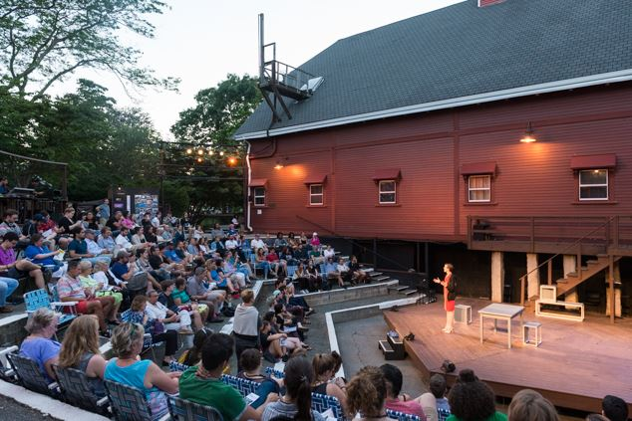
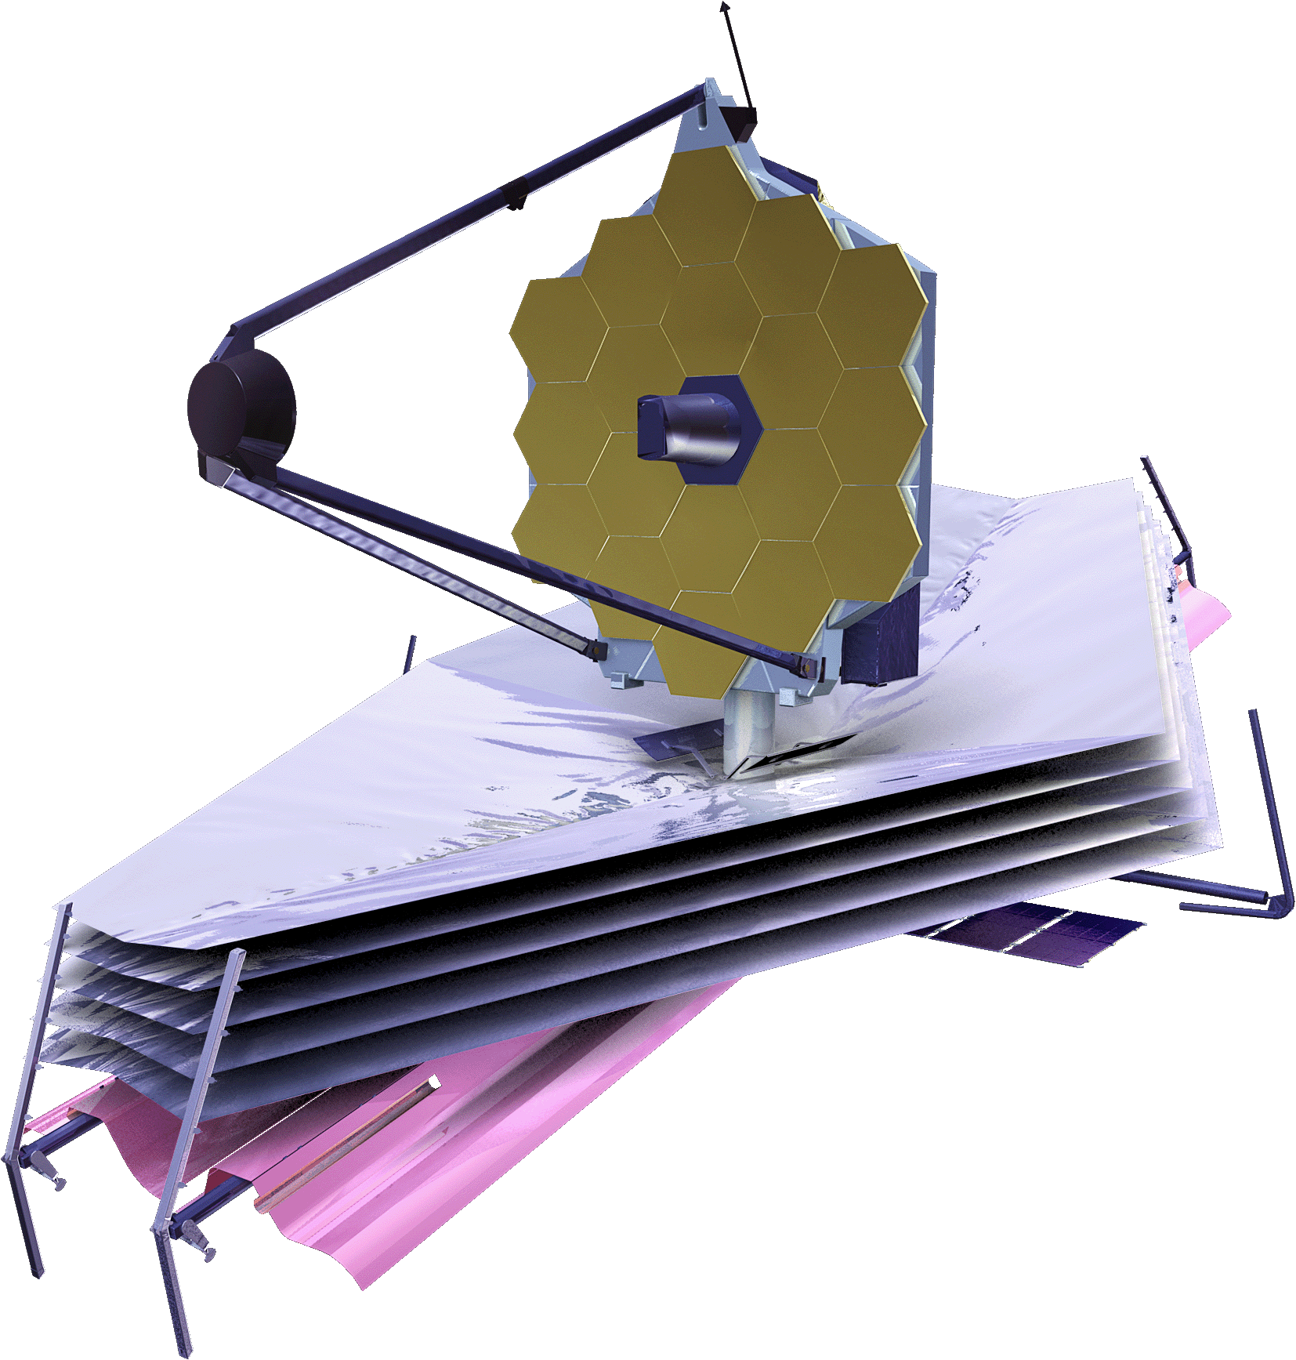


Development
o 2020-21: Working Title Playwrights Apprenticeship
o 4 Readings with Talkback
o July 2021: Concert Reading with Talkback
o Raised $2020 from 13 donors
o 2021-22: Theater Resources Unlimited
o 3 Musical Workshops
o December 2021: Director Lab
o ELLIPSES became 2022 Eugene O’Neill Theater Center Semifinalist
Notes:
[5] In 2020-2022, ELLIPSES went through this virtual process. Then in 2022, musicals started returning to the physical process. I began applying to countless staged opportunities. ELLIPSES became a 2022 Eugene O’Neill Theater Center semifinalist. [5-] ELLIPSES is the top 50 out of 400 musicals who applied, which is a monumental accomplishment in my career. Broadway shows incubate at the Eugene O’Neill Theater Center. [5] In terms of graphics, the logo also changed its color scheme as the [5--] James Webb Telescope picked up these colorations.

Slide 6
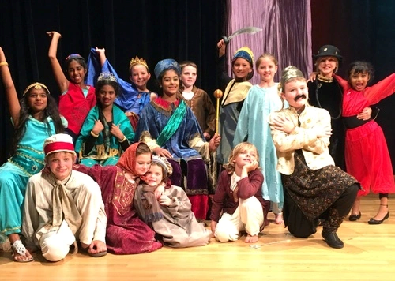
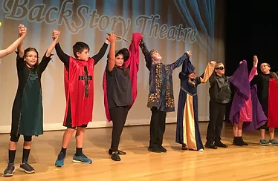

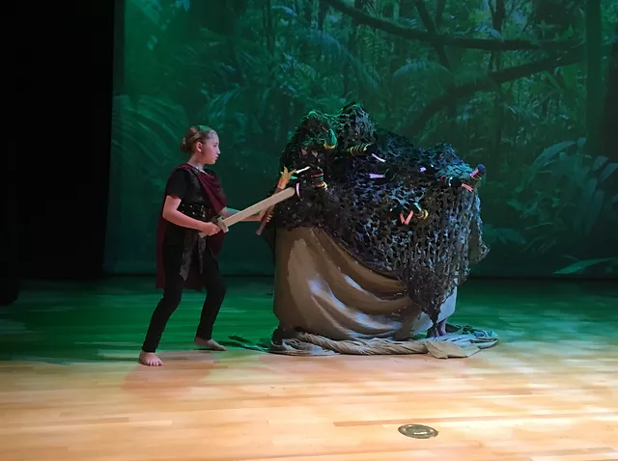
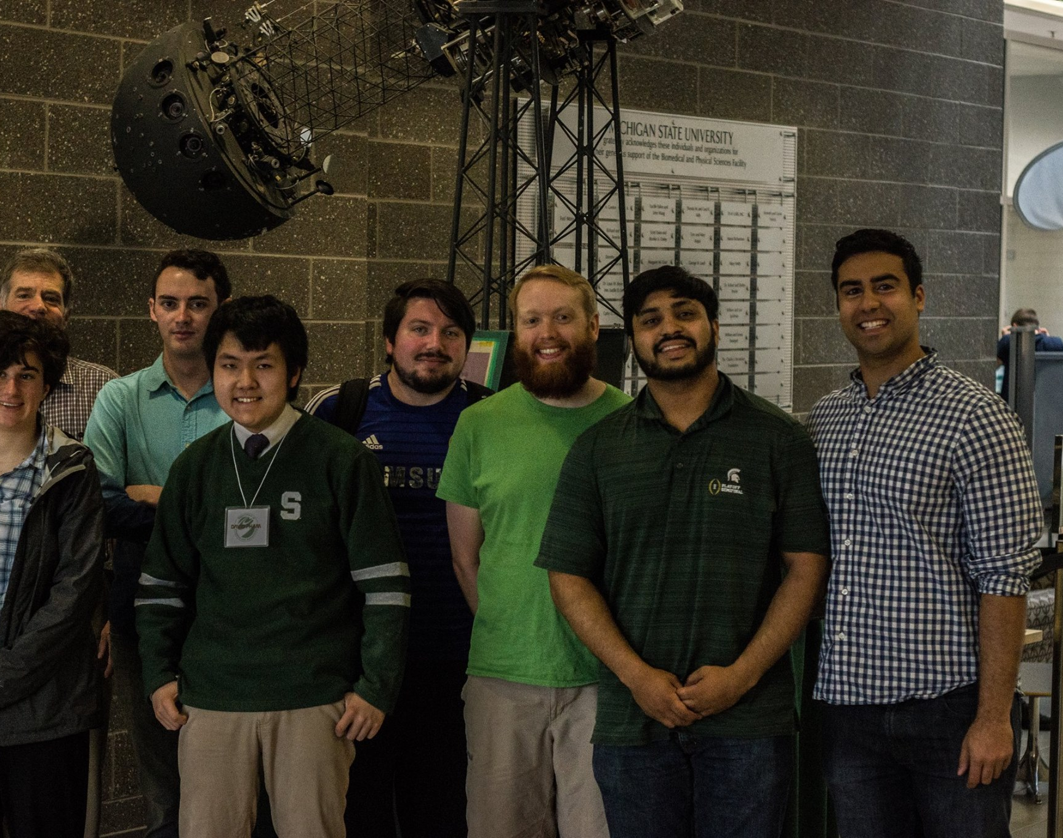
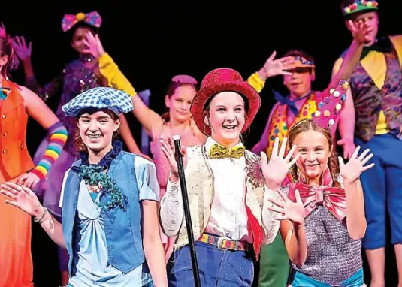
Notes:
[6] Last December, a musical writer spoke about Backstory Theatre in Broomfield, Colorado. Backstory Theatre produces children’s theatre. My peer told me to give ELLIPSES a shot in their annual Colorado New Musical Festival.

Slide 7
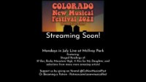
Notes:
[7] Here are shots of their second annual festival in 2021.

Slide 8
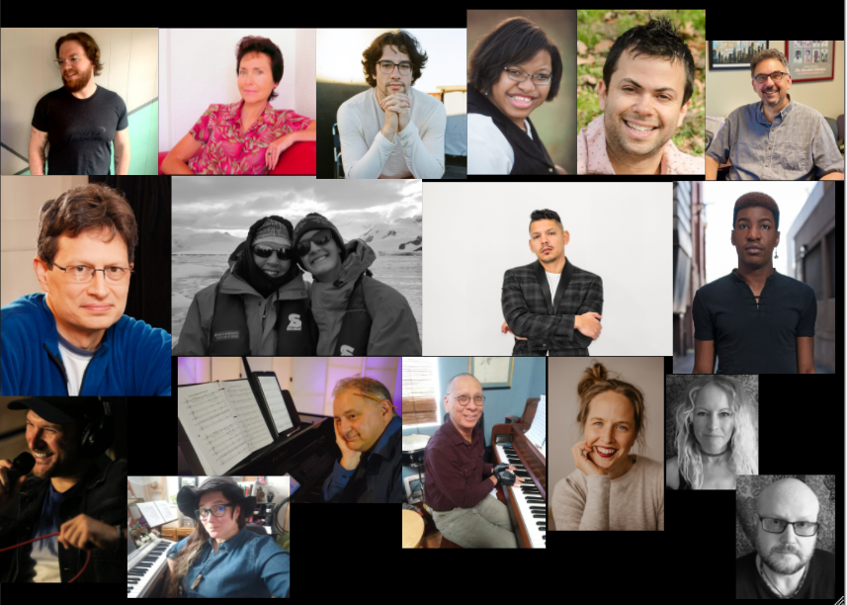
Notes:
[8] Here are the songwriters selected for the 2021 Colorado New Musical Festival.

Slide 9
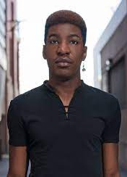
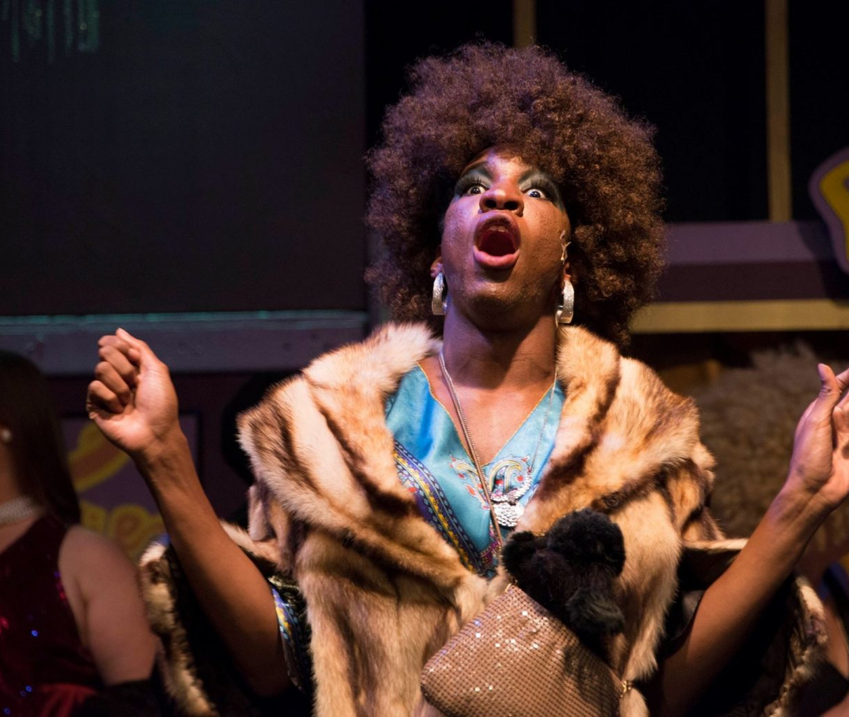
Preston Adams
Cofounder of Colorado New Musical Festival
Notes:
[9] Preston Adams, an opera singer and graduate of University of Northern Colorado…

Slide 10
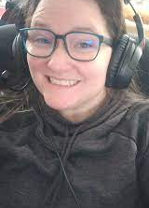
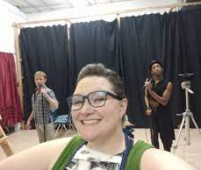
Kelly Bidstrup Graham
Cofounder of Colorado New Musical Festival
Notes:
[10] And Kelly Bidstrup Graham, an educator and graduate of University of Colorado, are cofounders of Colorado New Musical Festival.

Slide 11
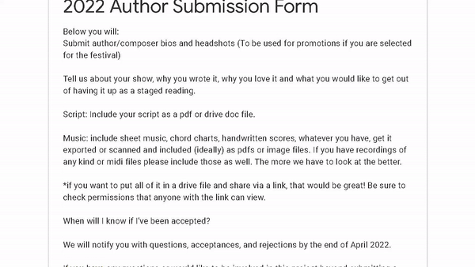
Notes:
[11] I applied with ELLIPSES in January 2022.

Slide 12
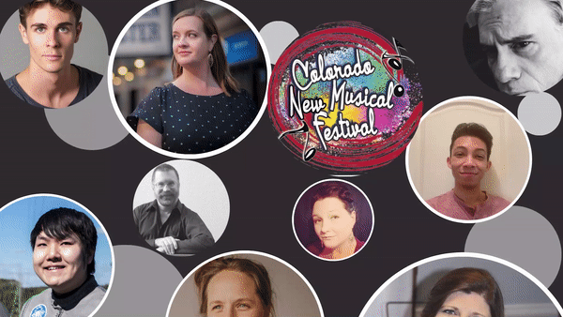
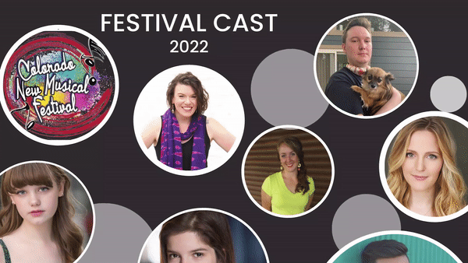
Notes:
[12] Then in April, within a pool of several dozen applicants, it was selected alongside eight other musicals, mostly from Colorado-based musical writers. I represented an outsider’s work, much like everyone here at DigiFest and me from the U.S.
We unilaterally decided that the song I wanted to develop was “Warps, Waves, and Wrinkles” with this children’s theatre group. It is a big production number near the end of first act when Milky Way learns to accept their adolescent self.
[12--] Between June and July, the team in Colorado virtually communicated with me while I’m in New York. They asked me questions about intentions of the characters and to reorchestrate music.

Slide 13
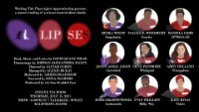
Notes:
[13] Here is Working Title Playwrights’s recording of “Warps, Waves, and Wrinkles.”

Slide 14
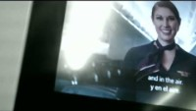
Notes:
[14] On July 17, I rode Delta from John F. Kennedy International Airport to Denver International Airport. It was my first flight since 2017. Here’s a chronology of the week.

Slide 15
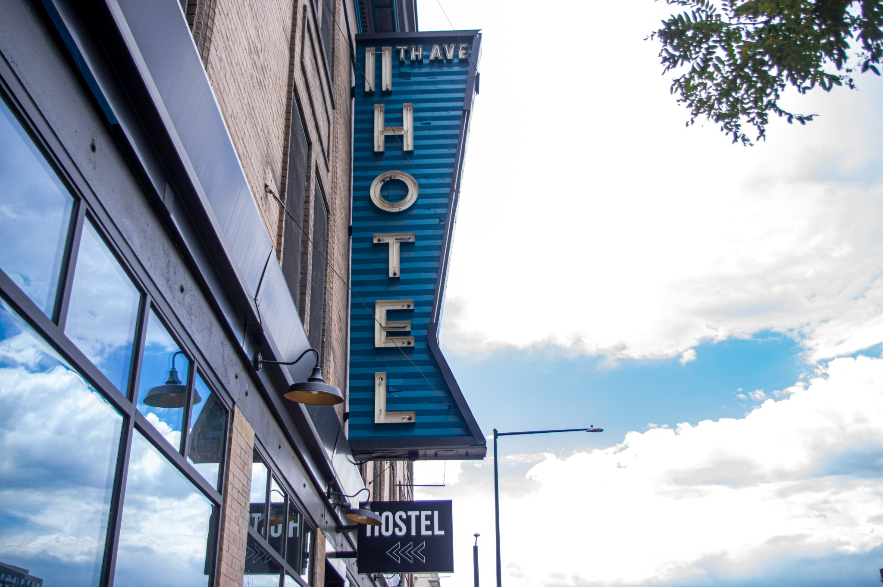
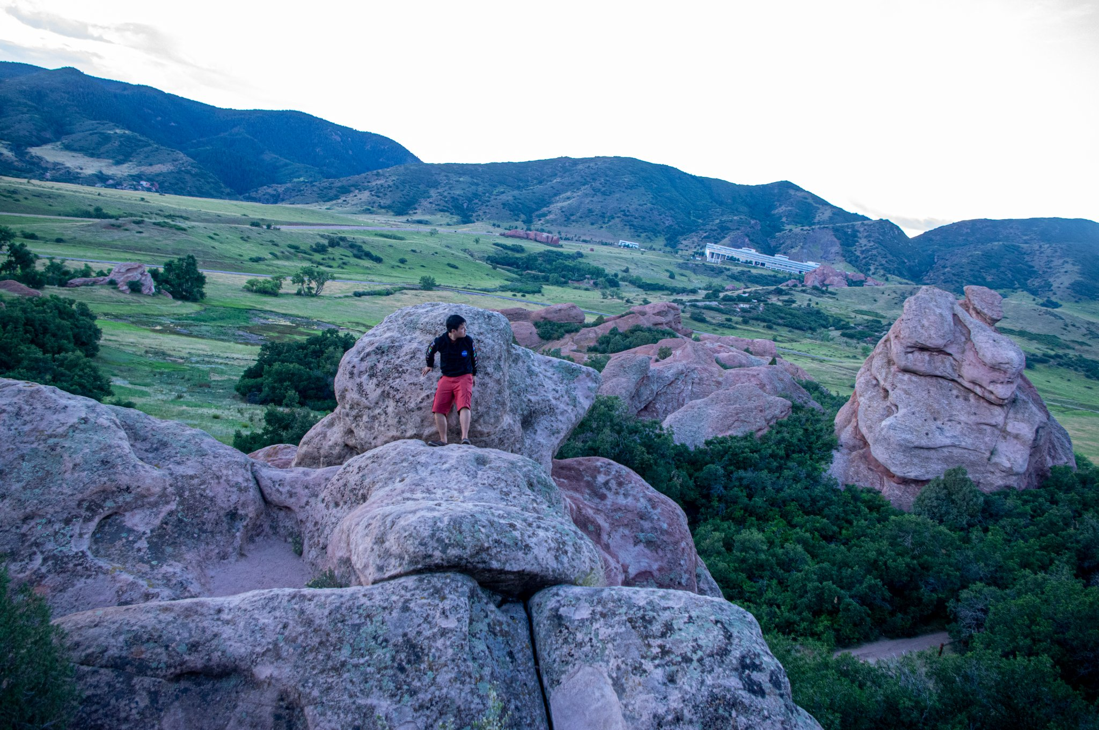
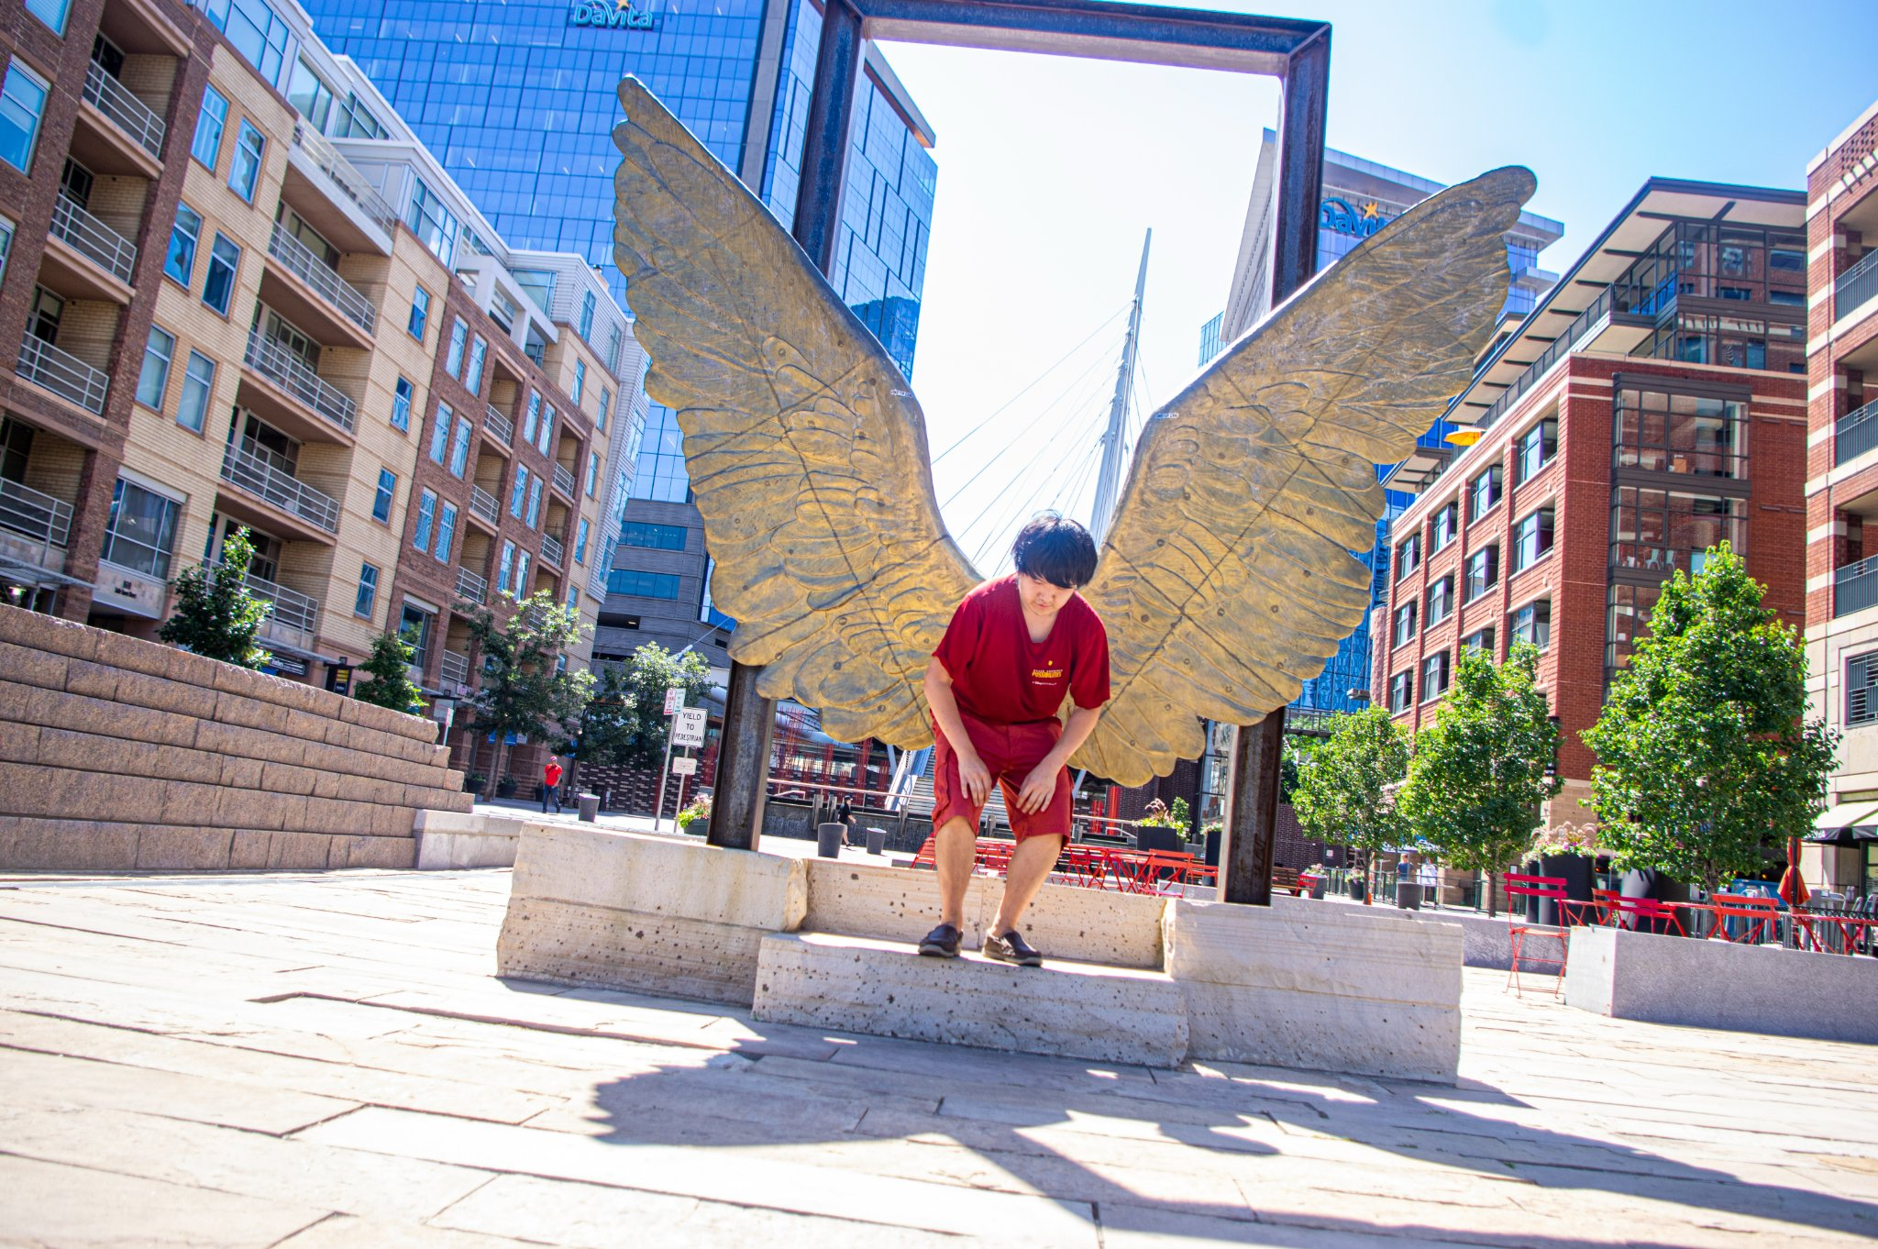
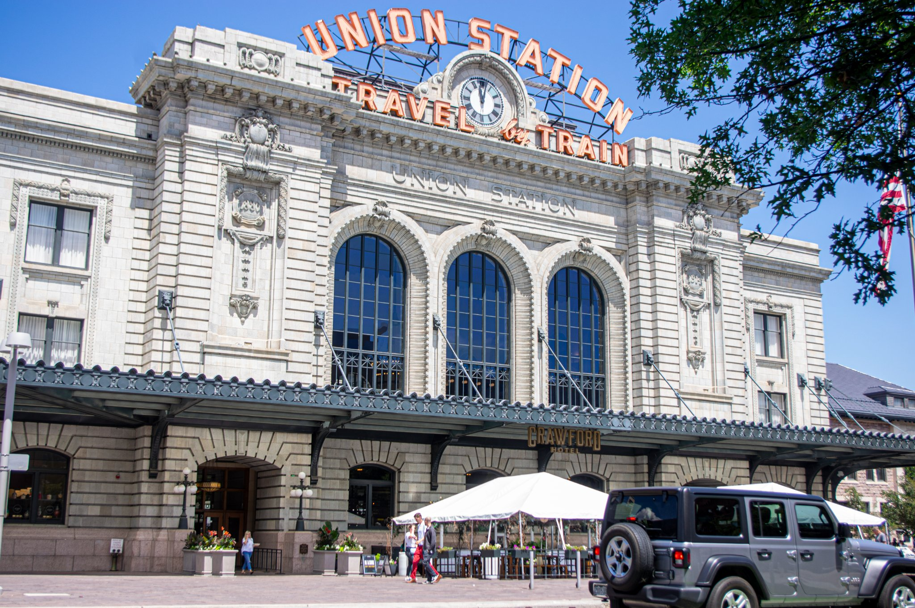
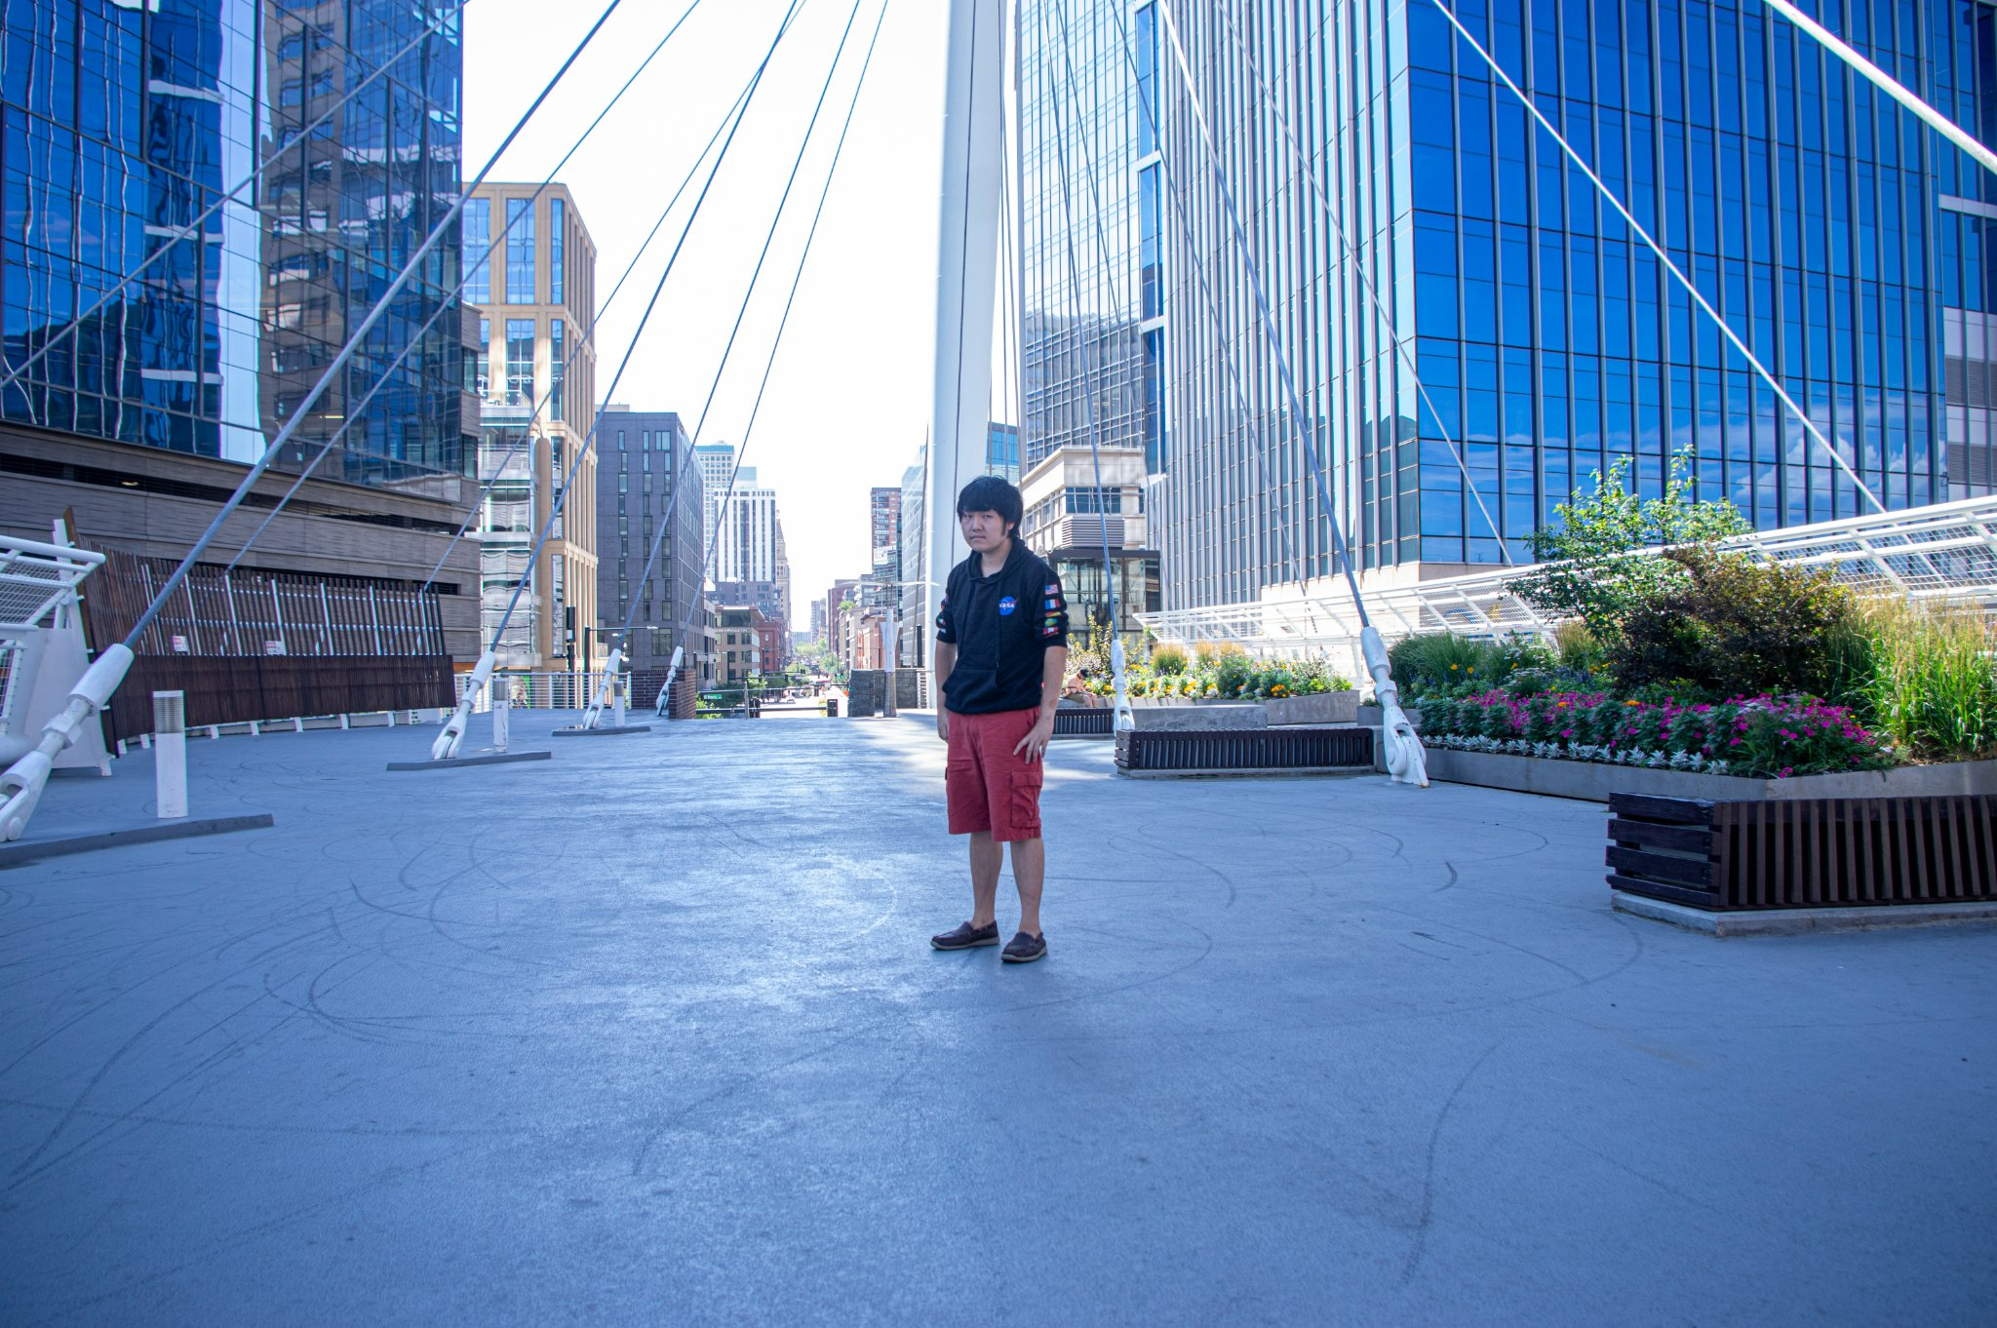
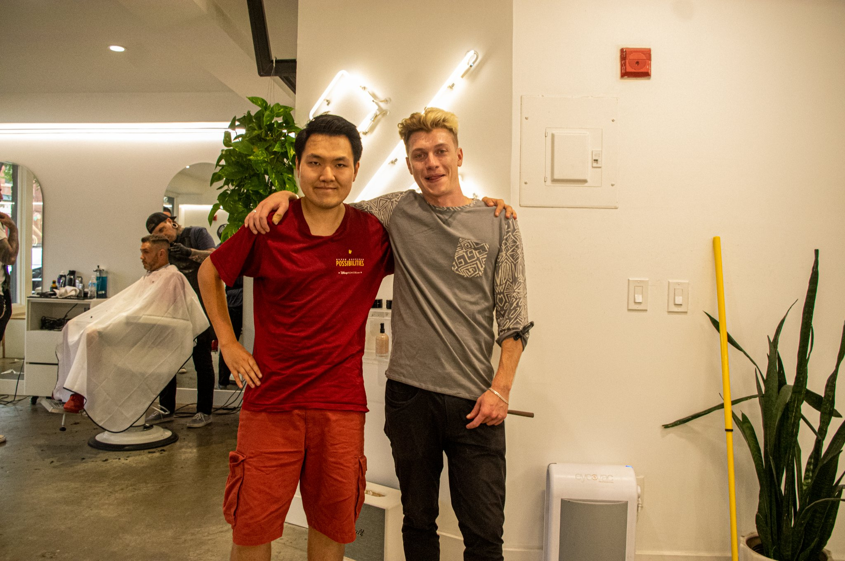
Notes:
[15] July 18, day one and my first time in Colorado. Needless to say: I goofed off. And speaking of “Romancing the Stone,” the theme of this year’s DigiFest. I climbed red rock formations. Shh… Don’t tell anyone especially the Park Rangers.

Slide 16
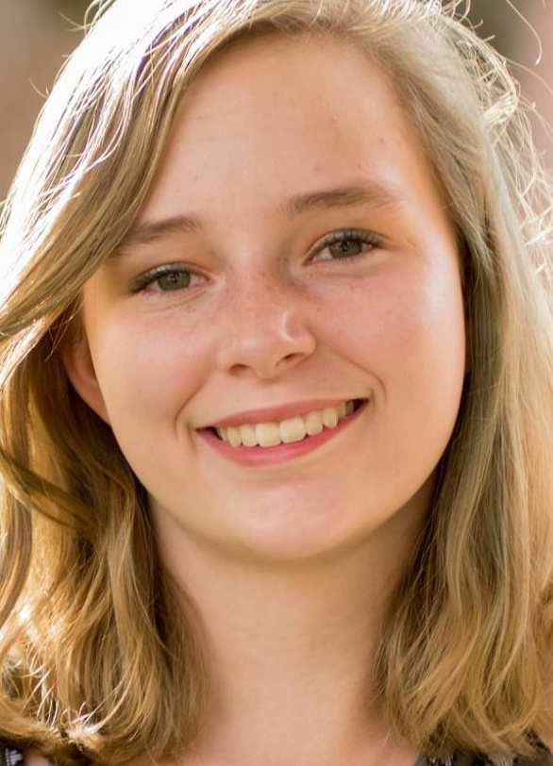
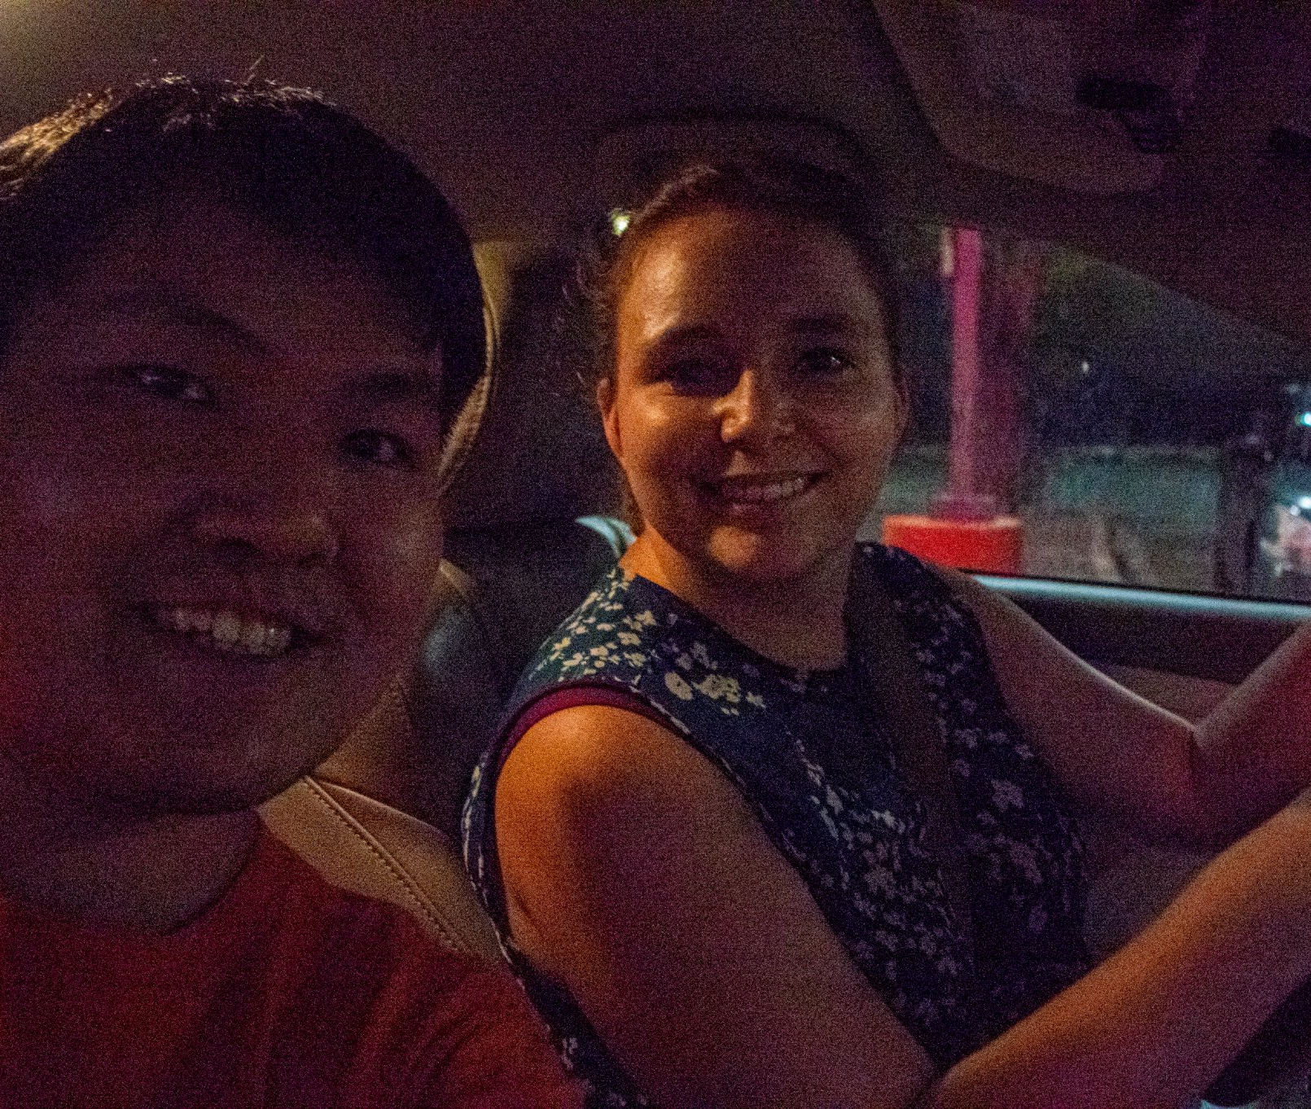
Emma Day
ELLIPSES Music Director / David’s Driver
Notes:
[16] July 19, Emma Day and I finally connected after virtually developing the music. Emma is my music director. She was also my driver from Denver to Broomfield.

Slide 17
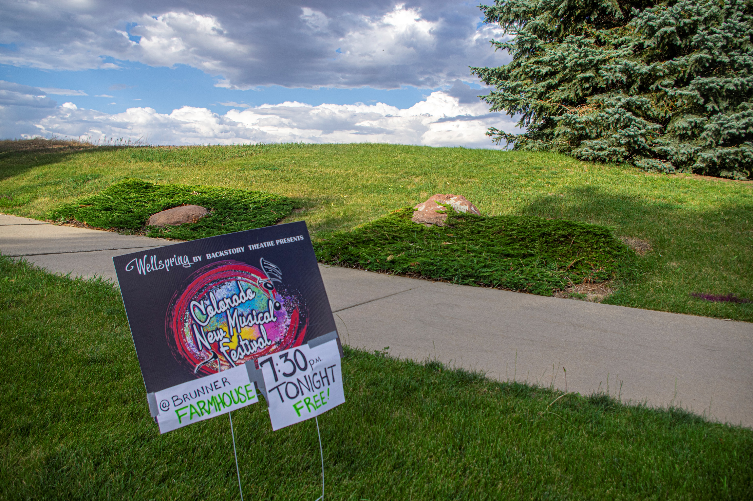
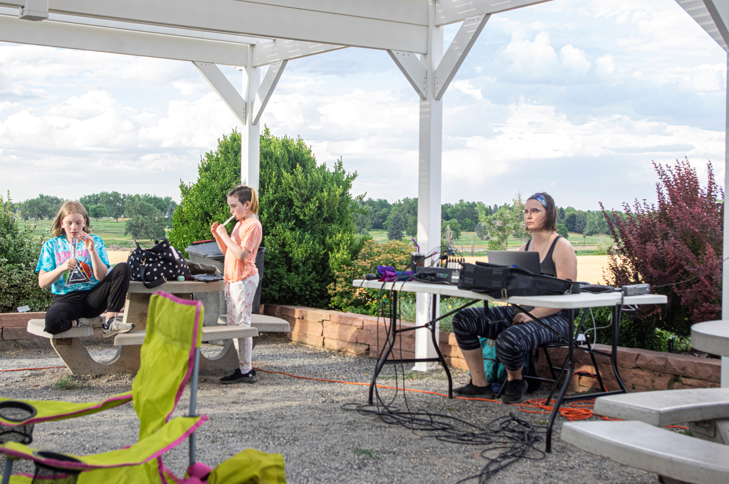
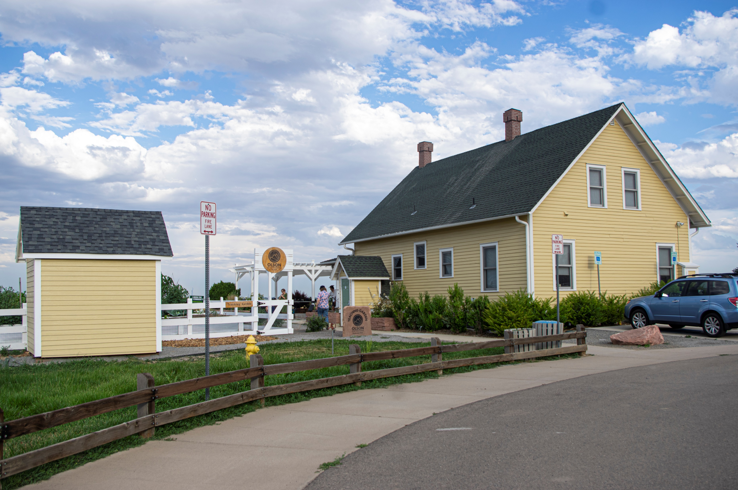
Notes:
[17] Here is Brunner Farmhouse. It was a 45-minute drive from 11th Avenue Hostel and public transportation is tumultuous. As a person who got used to 24-hour subways and buses, Denver does not have buses that came frequently. At the farmhouse, we got to see some showcases and check out rehearsals.

Slide 18
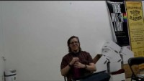
Notes:
[18] July 20, we are on our way to one of the rehearsals. Emma miscalculated some routes to get to the space, but we ended up witnessing a double rainbow. A physics phenomenon and a sign.

Slide 19
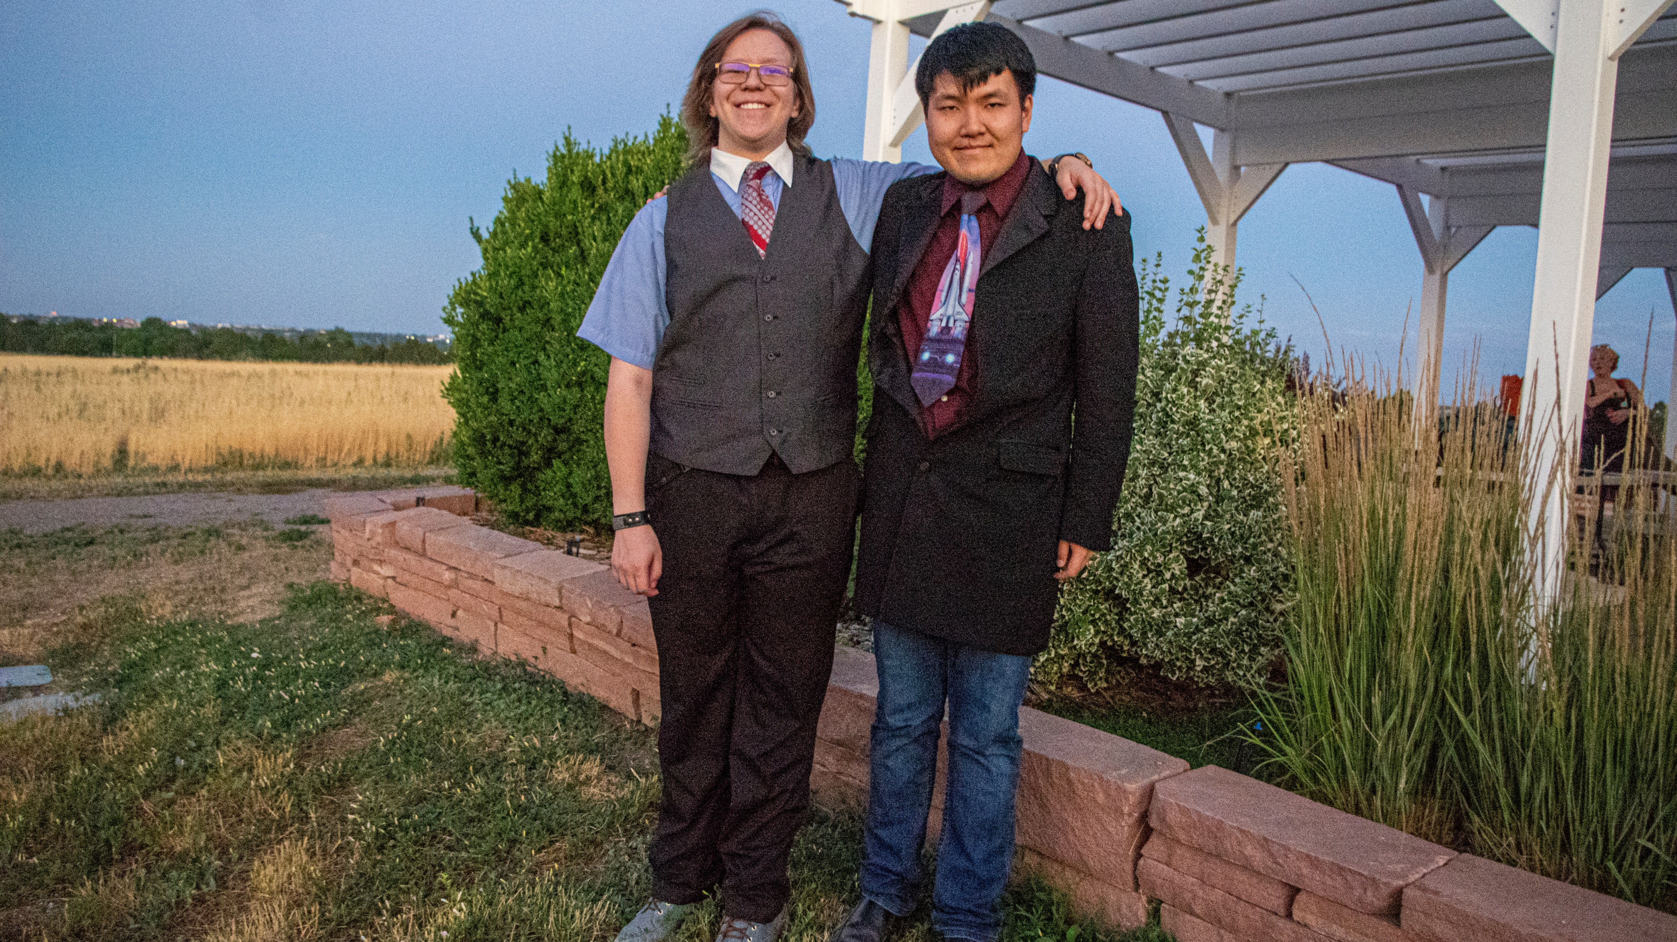
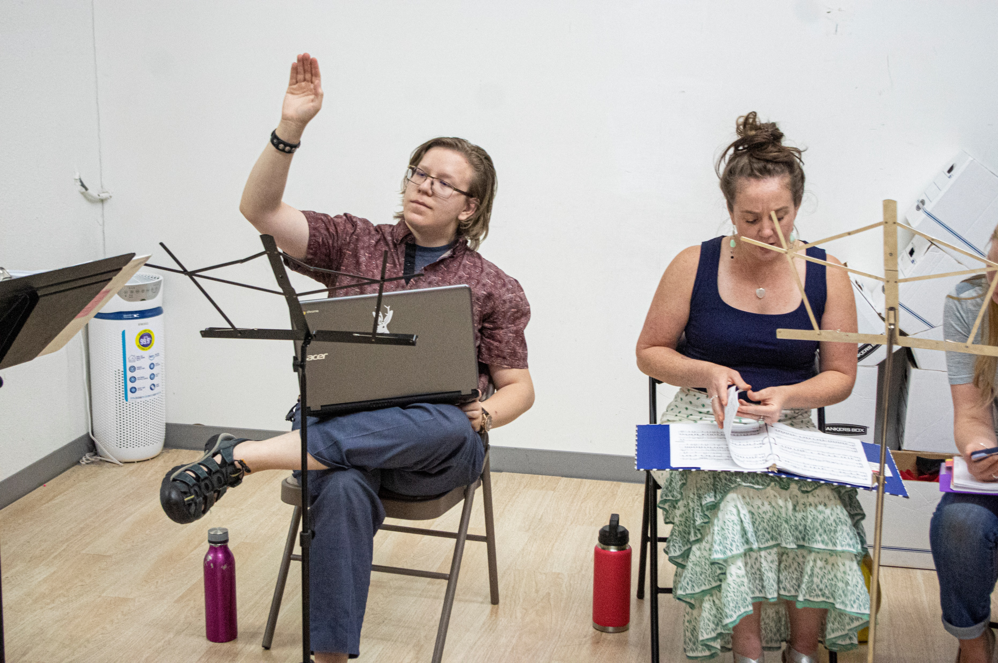
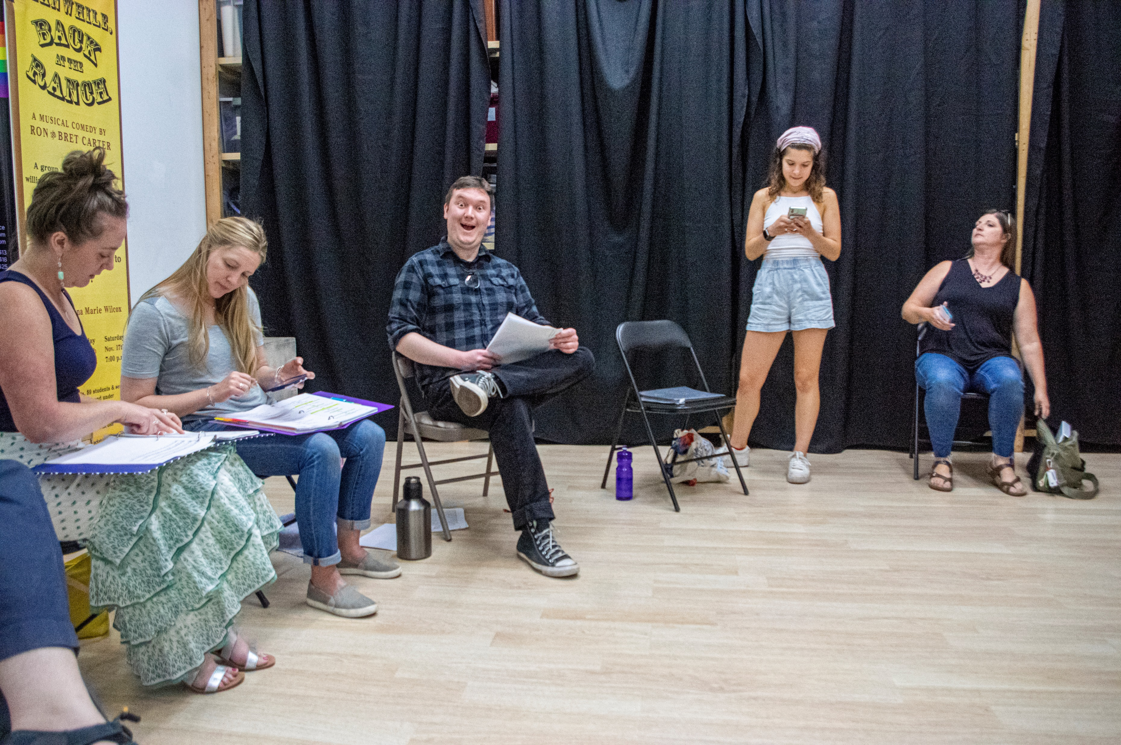
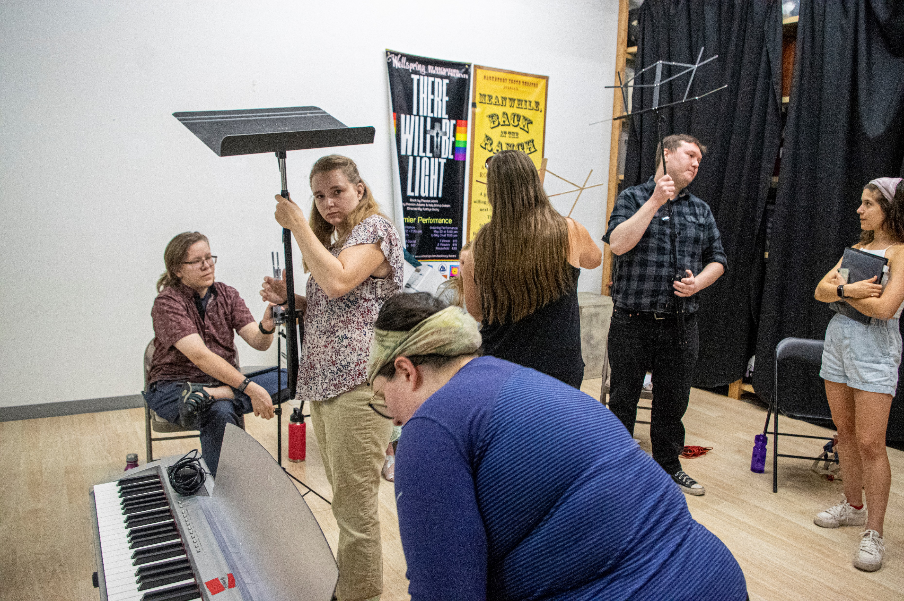
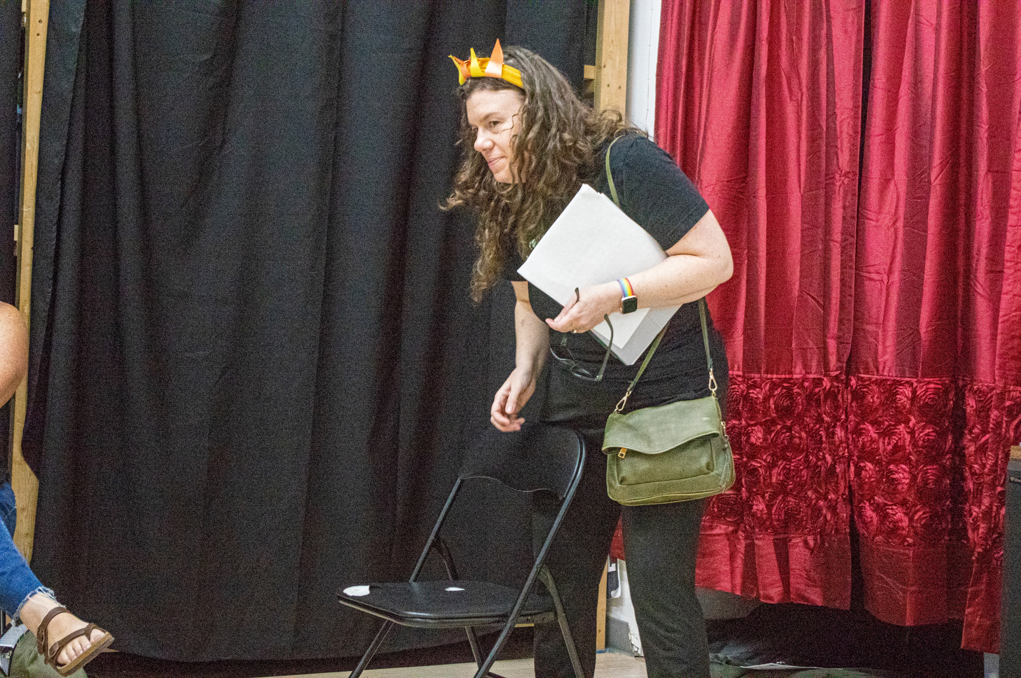
Notes:
[19] Backstory Theatre’s rehearsal space. It was one of my first times I developed my own work in a physical space. I was nervous when they asked for my thoughts, and I cannot turn off my camera. They can see my whole self fidget. But they were really supportive and truthful, stating the flaws of my score. During these, they tried to play a mandolin for my string orchestration of “Warps, Waves, and Wrinkles.” [19-] However, it had Jack Tyler’s hand in a pretzel.

Slide 20
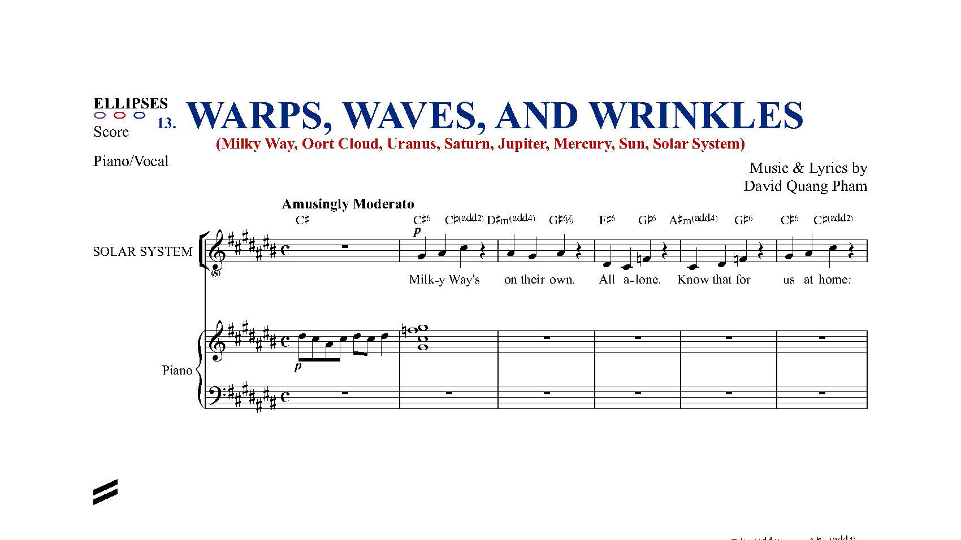
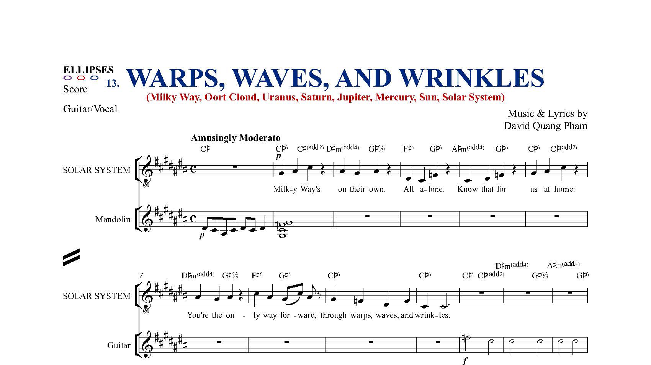
Notes:
[20] So, I had to reorchestrate for piano. [20-] It’s lame, but that is a lesson for me to speak to guitarists who know their stuff. I usually compose using my trombone and keyboard.

